Slide 1
CASE 1
Brittany Cody, DO
Mark Pool, MD
January 28, 2019

Slide 2
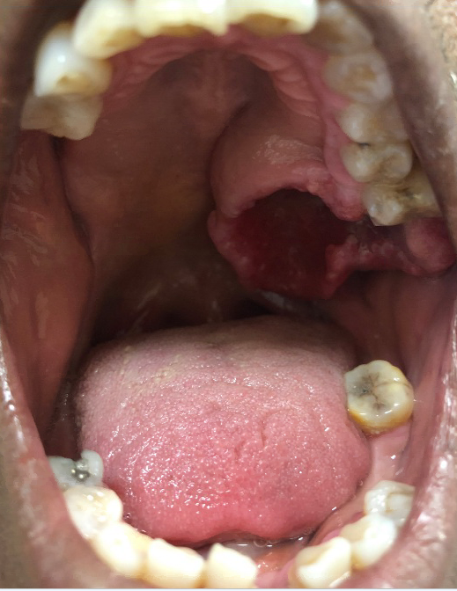
PHYSICAL EXAMINATION

Slide 3
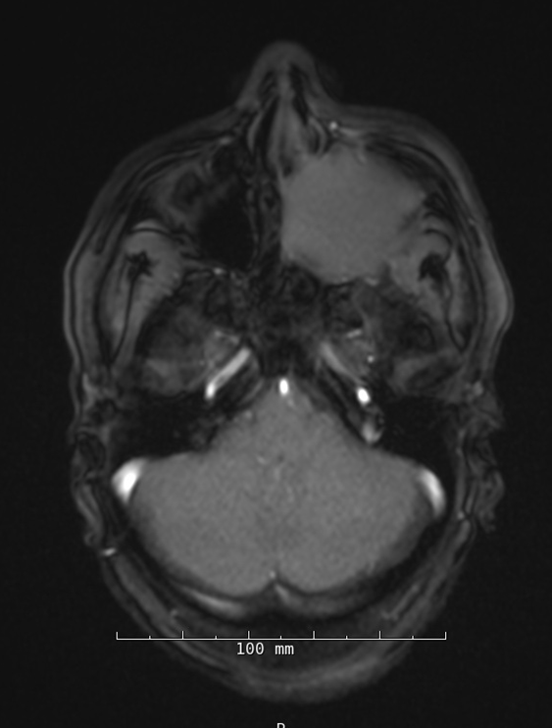
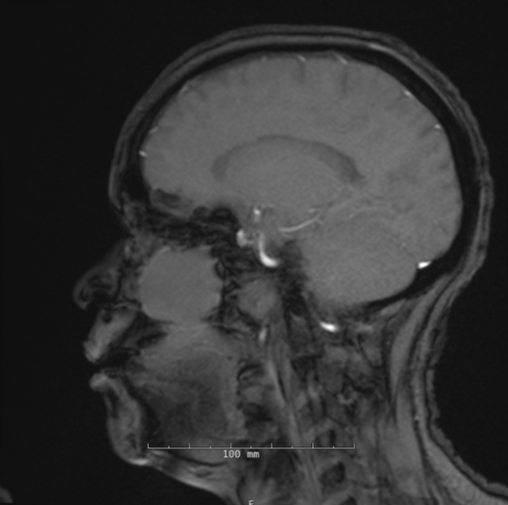
HEAD CT SCAN

Slide 4
CASE 2
Waqas Mahmud,MD
Paolo Gattuso, MD
January 28, 2019

Slide 5
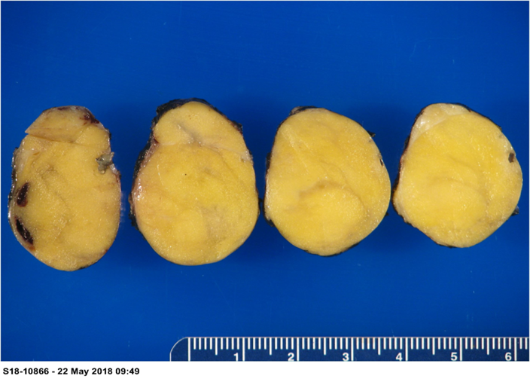
GROSS EXAMINATION

Slide 6
CASE 3
Prih Rohra, MBBS
David Cimbaluk, MD
January 28, 2019

Slide 7
H&E

Slide 8
H&E

Slide 9
PAS

Slide 10
IF: IgA

Slide 11
IF: Lambda

Slide 12
IF: Kappa

Slide 13
EM

Slide 14
EM

Slide 15
CASE 5
Jayjay Blanco, MD
Ritu Ghai, MD
January 28, 2019

Slide 16
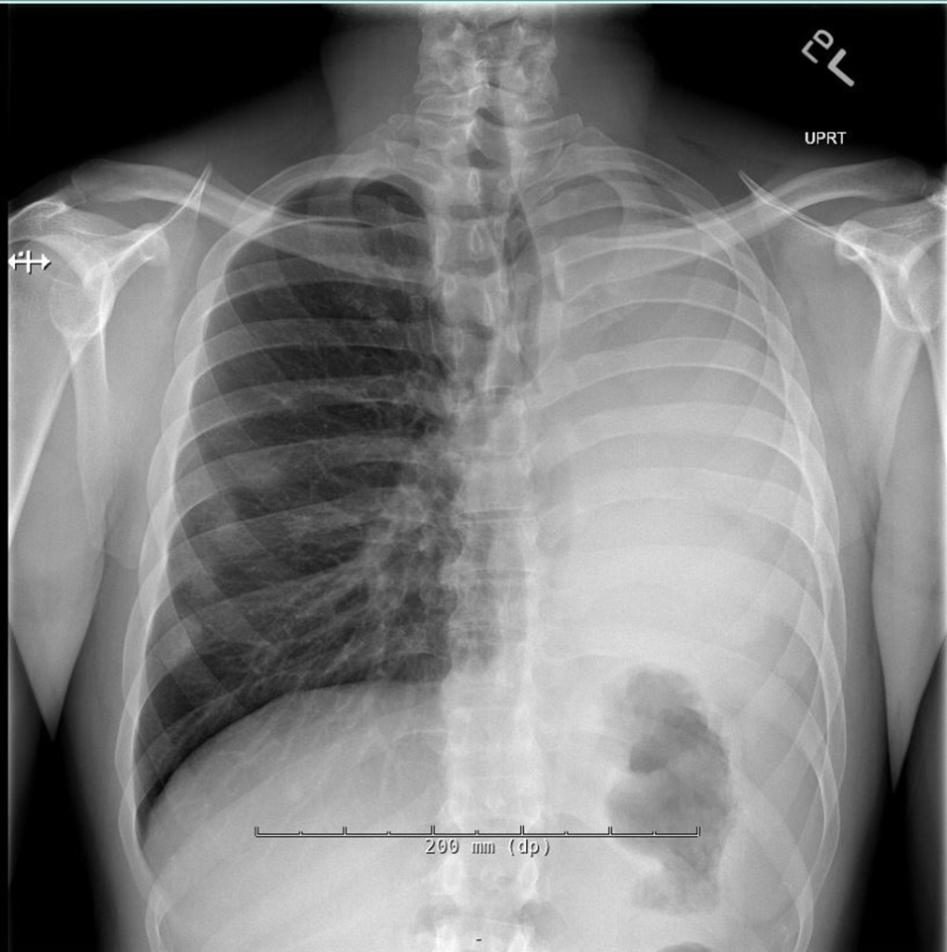
CHEST X-RAY

Slide 17
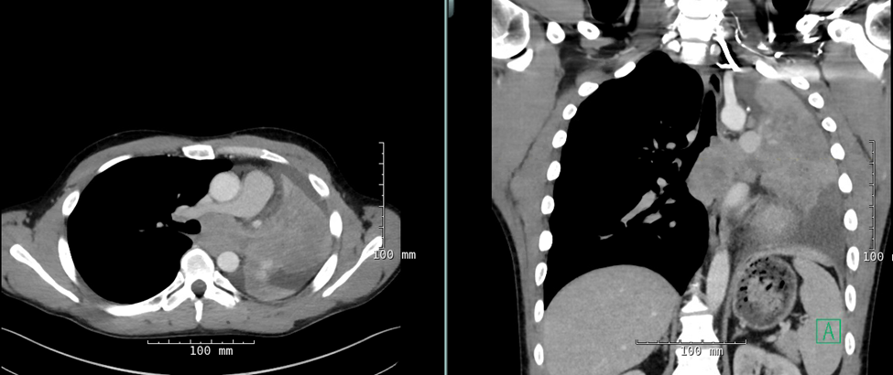
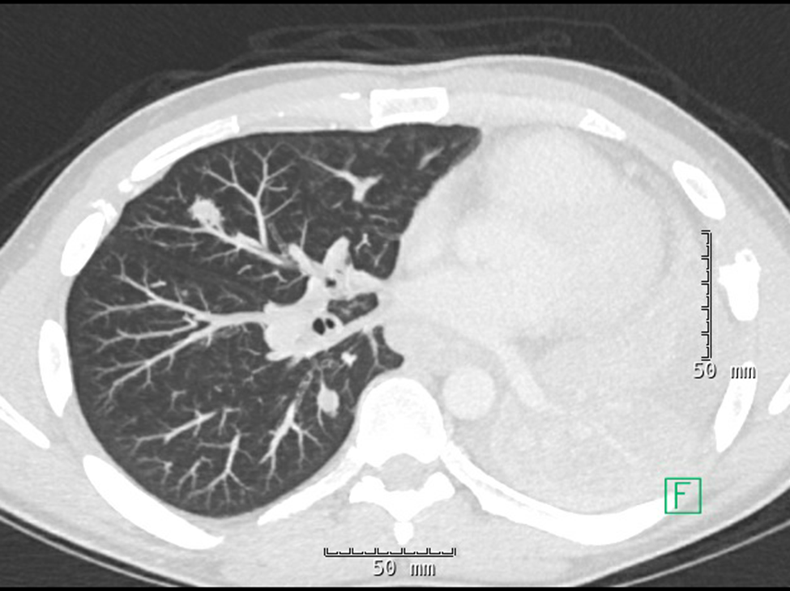
CHEST CT SCAN

Slide 18
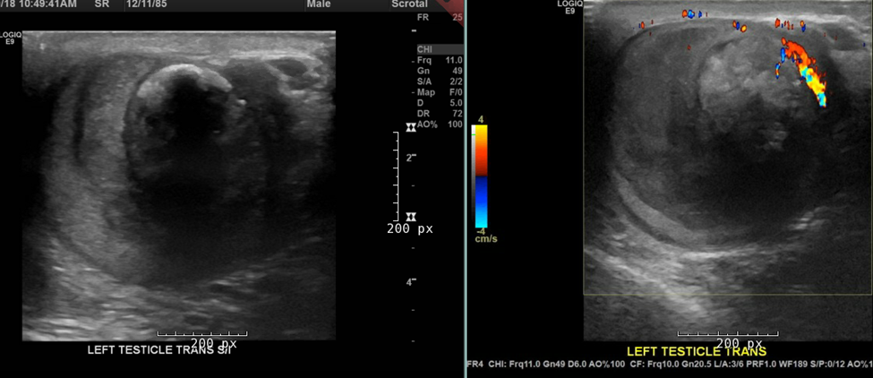
US OF SCROTUM AND CONTENTS

Slide 19
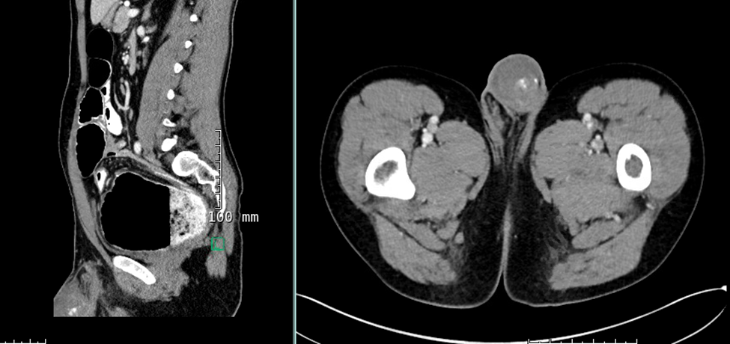
ABDOMINAL/PLEVIS CT SCAN

Slide 20
CASE 6
Josean Ramos, MD
Lin Cheng, MD
January 28, 2019

Slide 21
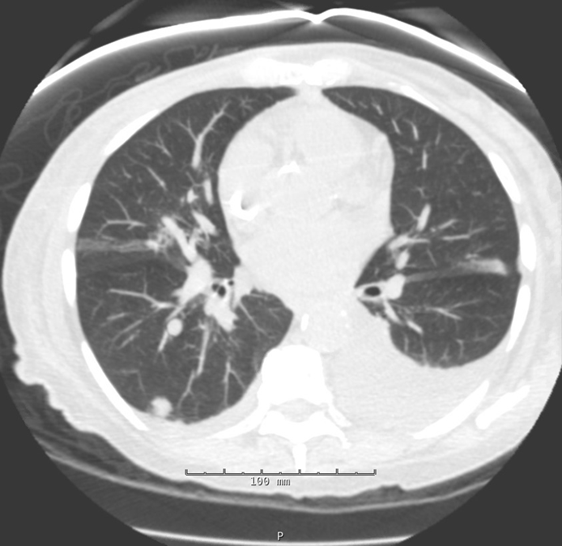
CHEST CT SCAN

