Slide 1
Loyola IRAP Preview
November 19th, 2018

Slide 2
Case #1
Presenter: Alessa Aragao, MD; Attending: Darius Borys, MD
A 51-year-old woman with a past medical history of left breast cancer diagnosed in 2009 and right breast cancer diagnosed in 2013, treated with bilateral mastectomy and chemoradiation, presented with intermitted chest pain. Imaging studies showed multiple small nodules in the lung and a 2.9 cm nodule in her right upper extremity. An excisional biopsy of the right upper extremity lesion was performed, a section of which is submitted for your review.

Slide 3
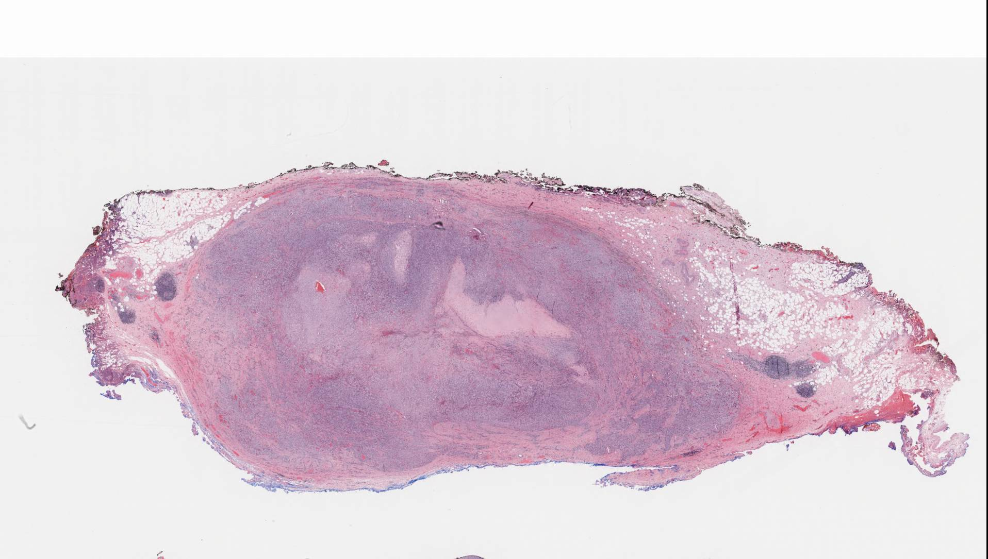
Notes:
Excisional biopsy showed a well circumscribed, unencapsulared nodular lesion with areas of increased cellularity and central more hypocellular region

Slide 4
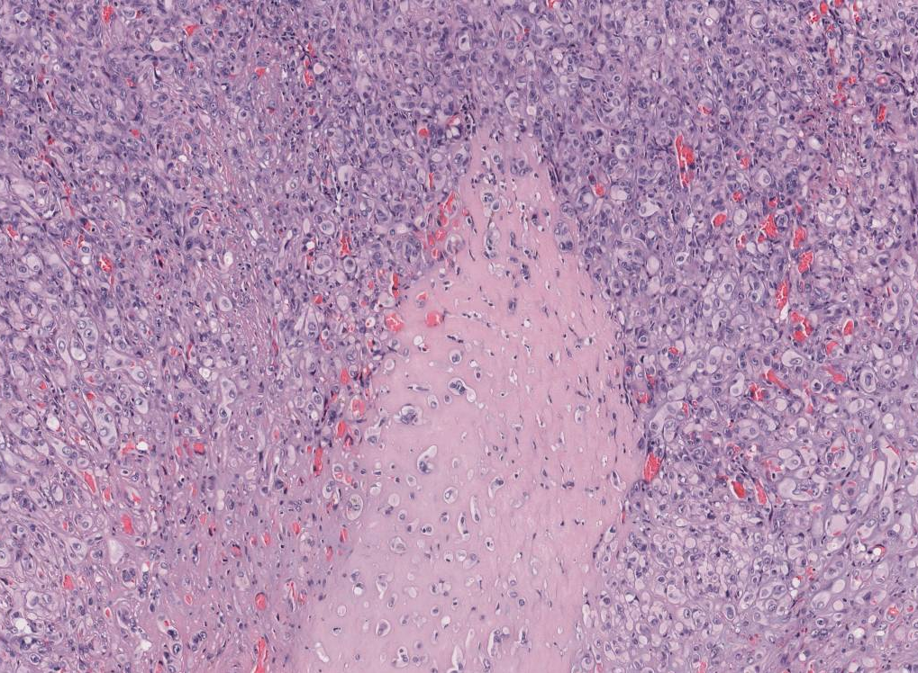
Notes:
From higher power we noticed the hypocellular areas are composed of a hyalinized stroma surrounded by epithelioid cell proliferation

Slide 5
Notes:
This image shows a vascularized lesion with proliferation of epithelioid cells and myxoid background

Slide 6
Notes:
We also noticed vacuoles in this lesion as shown by the black arrow and the adjacent image shows the epithelioid cells in a nested and more solid pattern

Slide 7
Case #2
Presenter: Recep Nigdelioglu MD; Attending: Dr. Xianzhong Ding, MD, PhD
A 29-year-old man with a past medical history of hypercholesterolemia was referred from an outside hospital for the workup of persistent mild elevation of transaminases for the past three years. His AST was in the range of 30-40 (N: 1 5-45IU/L) and his ALT was in the 50s (N:10-40 IU/L). His autoantibody tests for ANA (1:160) and ASMA (1:80) were both positive. He is a social drinker and doesn’t have a family history of liver disease. He has no relevant past surgical history, and his physical examination was unremarkable. His ultrasound demonstrated a normal sized liver with normal parenchymal echogenicity and scattered calcifications. Due to his persistent elevated transaminase levels and positive autoimmune markers, a percutaneous liver biopsy was performed. A representative section is submitted for your review.

Slide 8
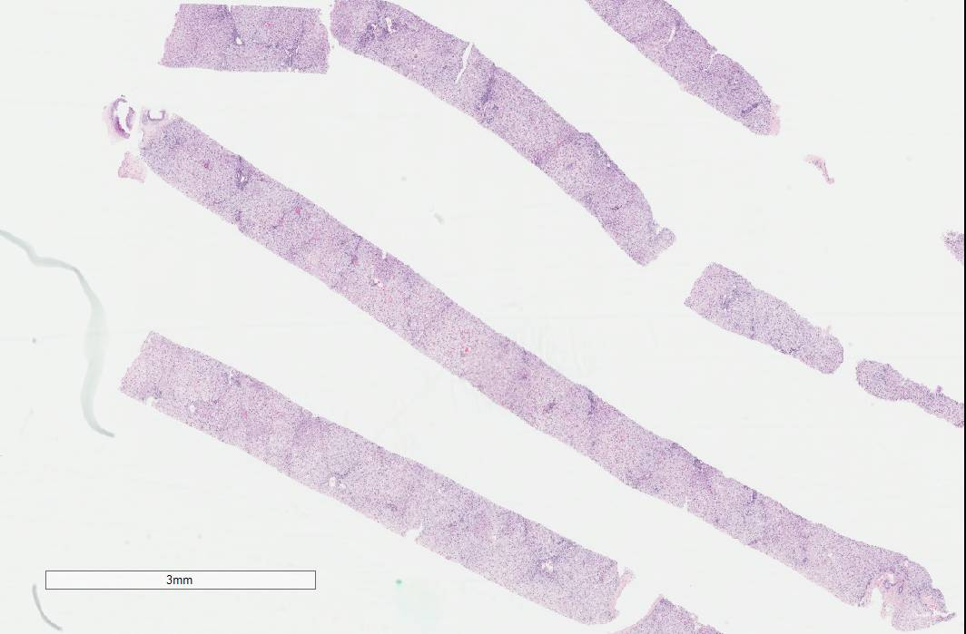
2x
Notes:
Here at low power we see multiple cores of liver biopsy and hepatocytes are diffusely pale

Slide 9
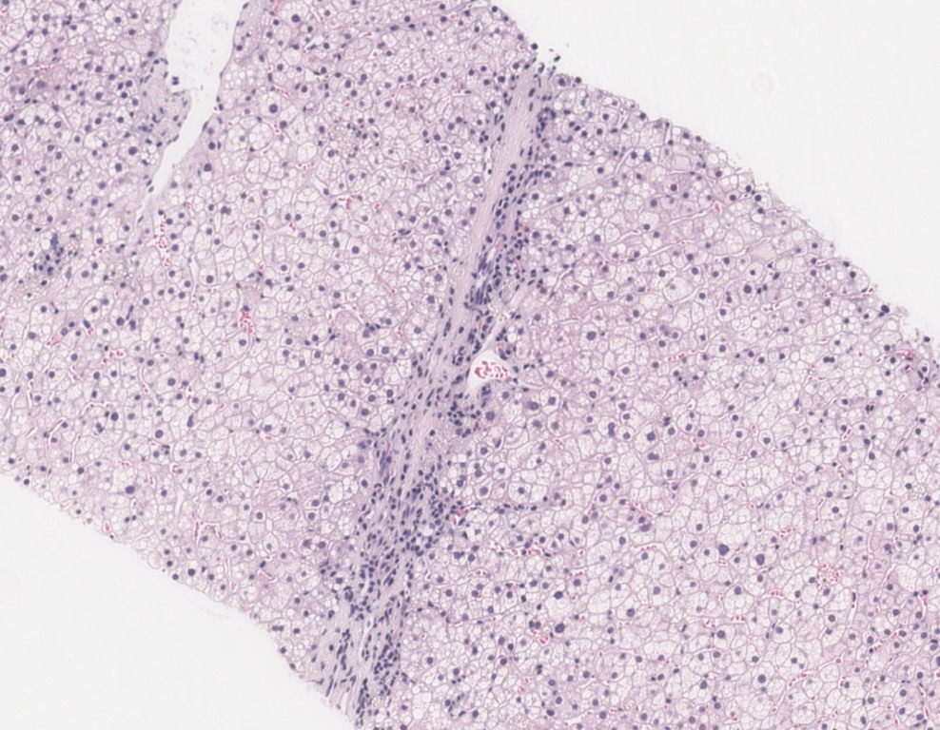
Notes:
On high power, We can appreciate delicate bridging fibrosis with minimal portal and lobular inflammation. The hepatocytes are diffusely enlarged with intracytoplasmic vacuoles

Slide 10
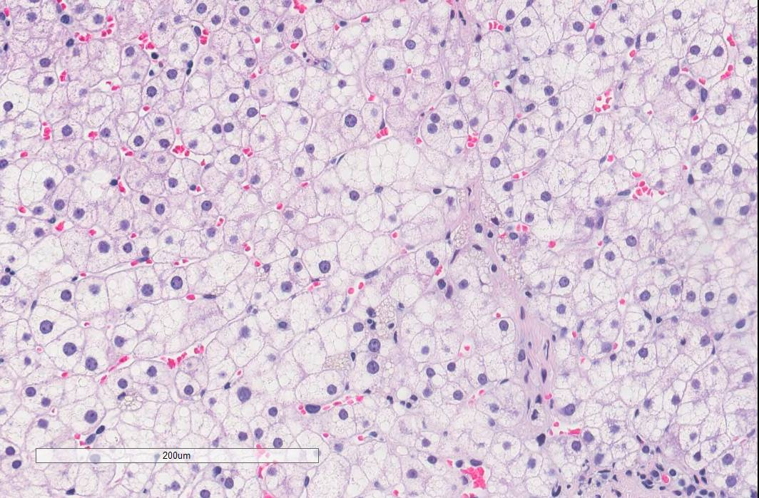
Notes:
At higher magnification, these intracytoplasmic vacuoles in hepatocytes are mostly consistent with fat dropletes. These fat droplets are mainly medium sized and there is no significant large sized fat droplets. There is patchy small size fat droplets suggestive of microvesicular steatosis.

Slide 11
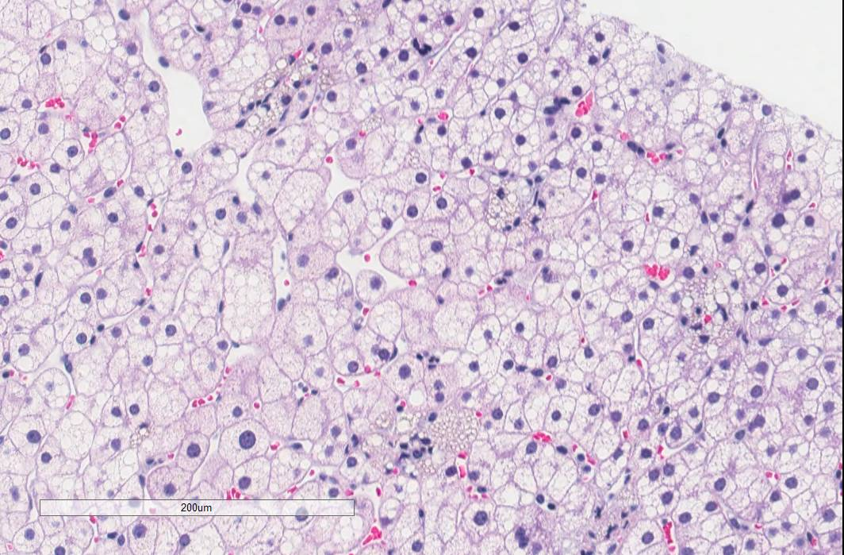
20x
Notes:
In addition to hepatocytes Kuppfer cells are filled with these intracytoplasmic vacuoles

Slide 12
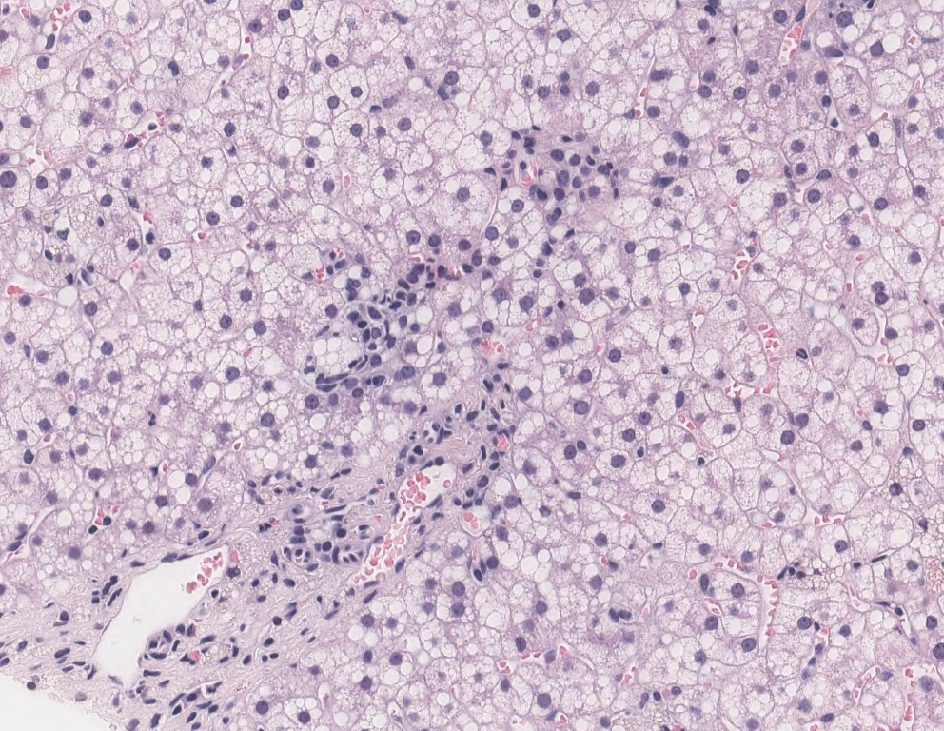
20x
Notes:
As well as macropphages at portal areas. There is no significant hepatocyte ballooning and Mallory-Denk bodies.

Slide 13
Case #3
Presenter: Schuharazad Abro, MBBS; Attending: Swati Mehrotra, MD
A 66-year-old woman with a past medical history of acute myeloid leukemia, treated with stem cell transplantation which was complicated by graft versus host disease, presented with dysphagia, voice change, and an oral lesion. Physical examination showed a 3.0 cm exophytic mass in her left oropharynx. An excisional biopsy was performed. A representative slide of the mass is submitted for your review.

Slide 14
Notes:
On histology we see squamous epithelium with focal area of inflammation as pointed by black arrow and mass mainly present in submucosal tissue

Slide 15
Notes:
This power shoes that the mass is composed of spindle cells forming fascicles and some what whorling pattern

Slide 16
Notes:
There were also focal areas of loose myxoid stroma

Slide 17
Notes:
And necrosis

Slide 18
Notes:
On high power the spindle cells appear monomorphic with centrally located elongated nucleus with blunt ends and small dot like prominent nucleoli. There is also dense acute inflammation in background

Slide 19
Case #4
Presenter: A. Irem Kilic MD; Attending: Stefan Pambuccian, MD
A 70-year-old man with a history of cirrhosis, portal hypertension, and coagulopathy presented with fatigue, poor appetite, and abdominal pain. Imaging revealed multiple liver lesions, an 8 mm solitary lesion in the lower lobe of the right lung, and irregular thickening of the walls of the esophagus and stomach. Transabdominal CT-guided fine needle aspiration and needle core biopsy of the liver were performed. Flow cytometry of the aspirate and initial IHC stains for cytokeratin (AE1/AE3 and 8/18), S100, CD3, CD20 and CD45 were negative. Representative images of the liver aspirate and core biopsy are submitted for your review.

Slide 20
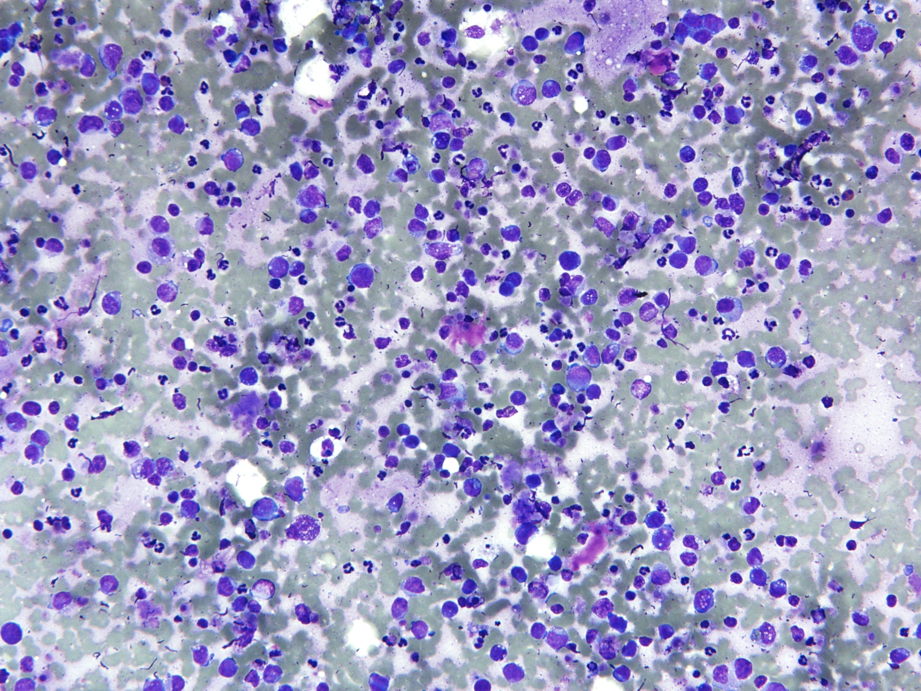
Notes:
An FNA of the liver lesion was performed and showed a cellular specimen composed of discohesive cells.

Slide 21
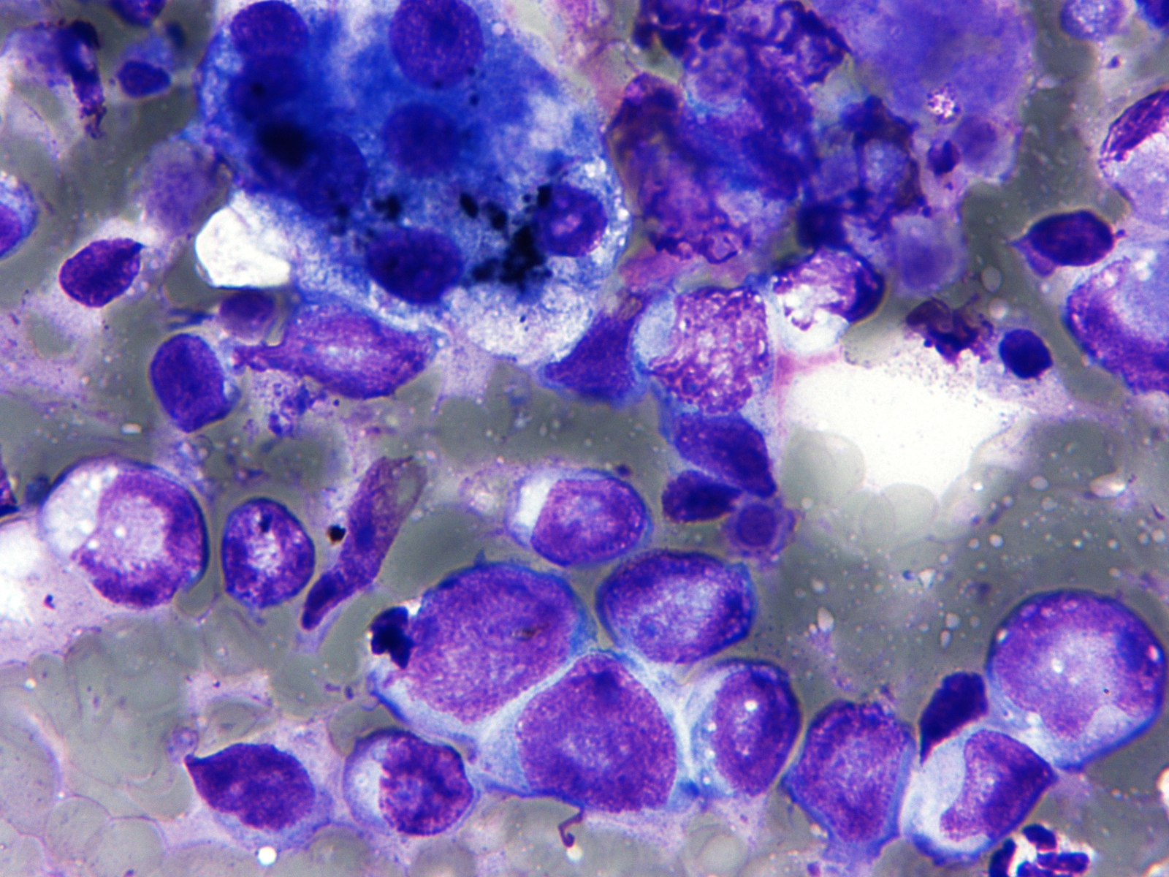
Notes:
On higher power we can appreciate benign appearing hepatocytes next to the atypical cells which show irregular nuclear contours and high N/C ratio, some of them with eccentric nuclei and intracytoplasmic microvesicles.

Slide 22
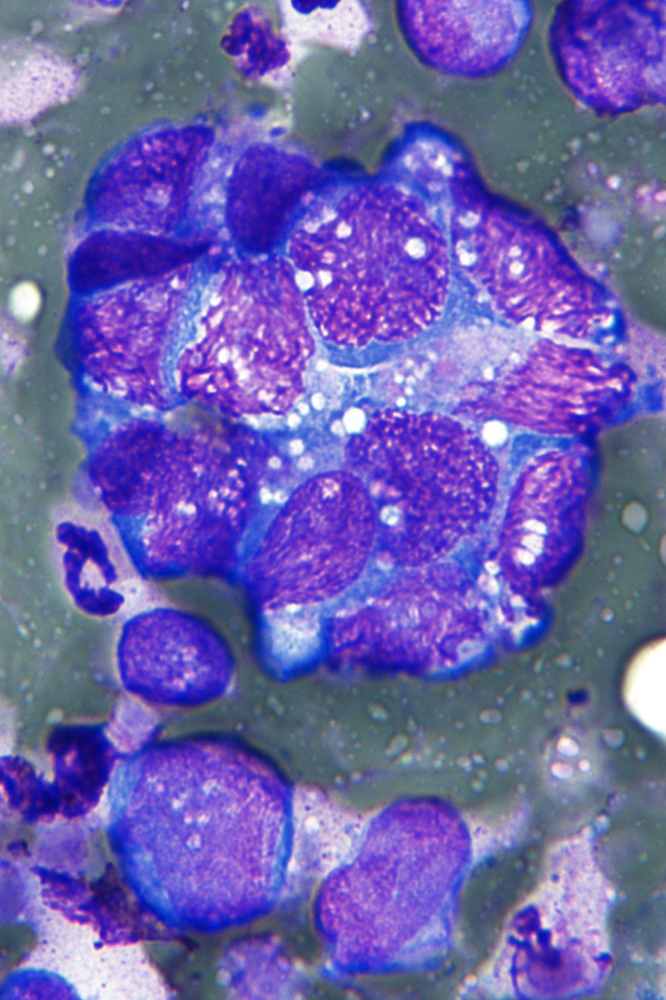
Notes:
In other areas, there are nuclear streaking and nuclear crush artifact of the malignant cells as well as loosely cohesive clusters.

Slide 23
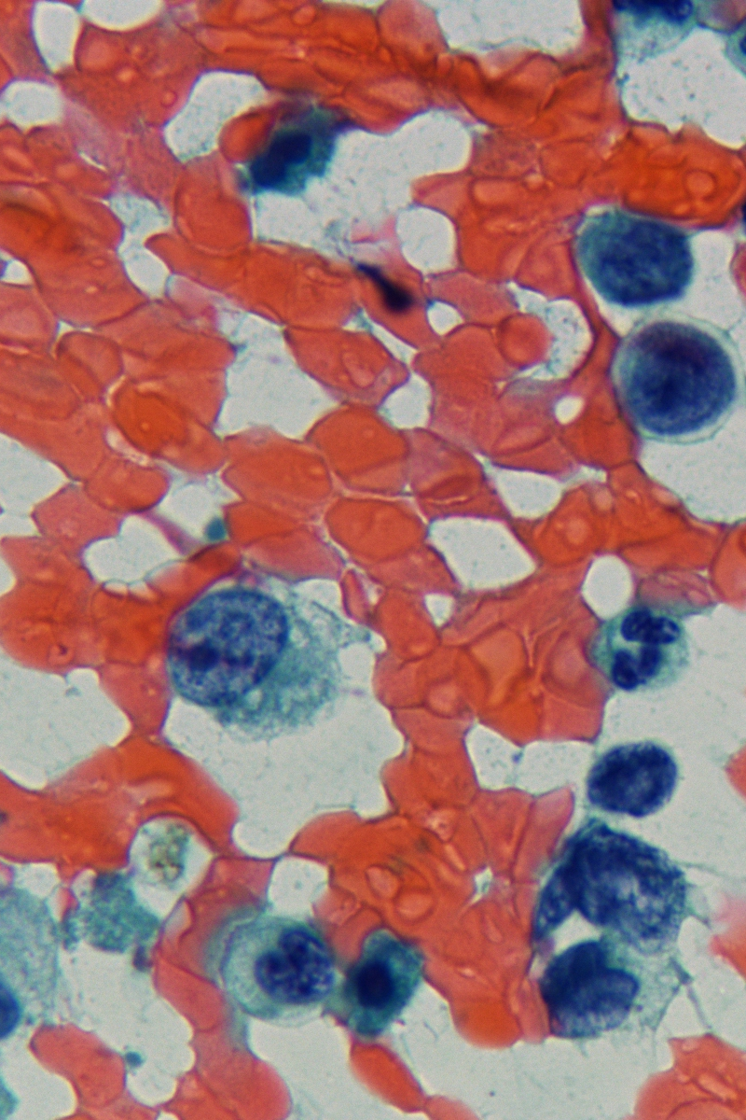
Notes:
Papanicolaou stain highlights the nuclear features of tumor cells including vesicular chromatin and macronucleoli.

Slide 24
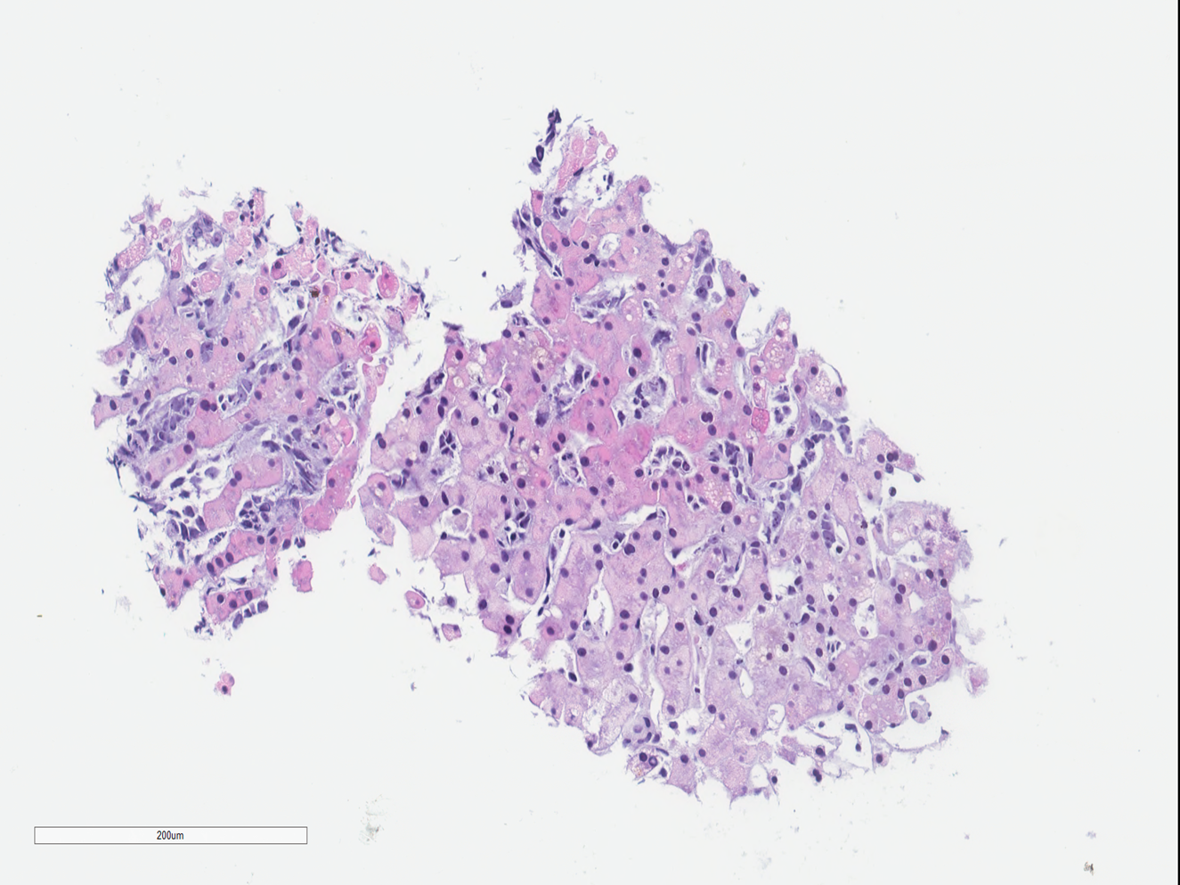
Notes:
A subsequent liver biopsy was performed and an infiltration of undifferentiated cells within the sinusoids is identified.

Slide 25
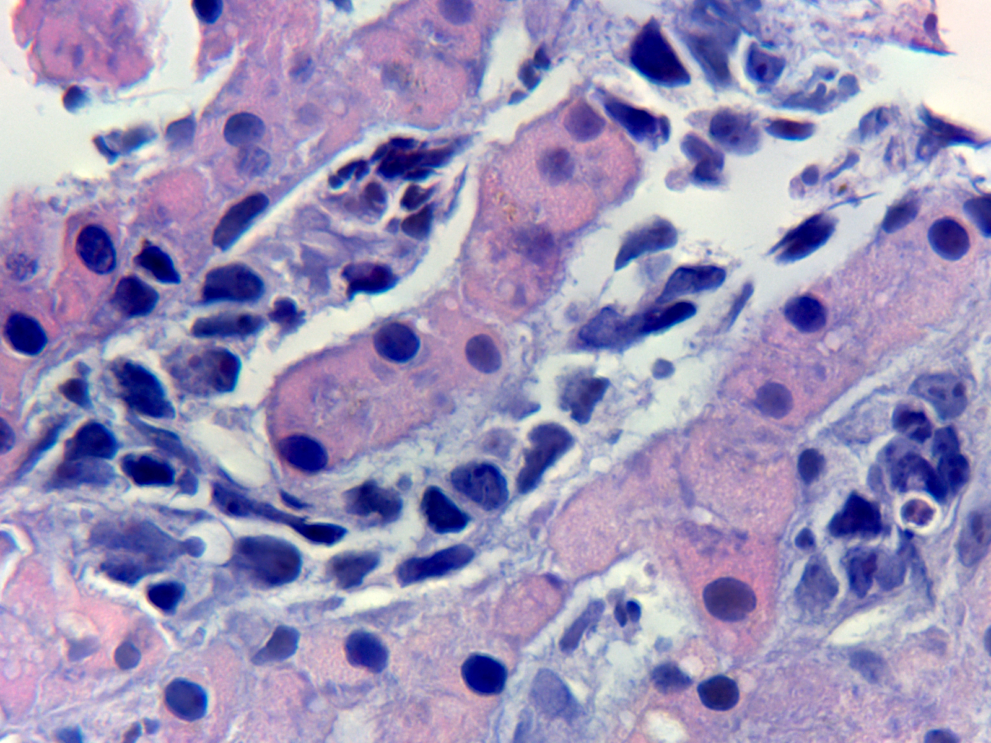
Notes:
On higher power, these cells show undifferentiated morphology, high N/C ratio and prominent nucleoli, focally they have intracytoplasmic microvesicles and rhabdoid-like features.

Slide 26
Case #5
Presenter: Daniel E. Dresser, MD; Attendings: Ewa Borys, MD; Stefan Pambuccian, MD
A 31-year-old woman presented with six months of headaches, night sweats, and diplopia. Her past medical history included asthma and a TSH-secreting pituitary adenoma which was treated with partial resection and radiation therapy. The brain MRI performed at the current presentation demonstrated a 2.8 cm lobulated mass within the right aspect of the sella turcica. Transsphenoidal partial resection of the mass was performed and the lesional tissue is submitted for your review.

Slide 27
Notes:
On medium power, H&E sections demonstrate a cellular lesion with intersecting fascicles of spindle cells.

Slide 28
Notes:
Adjacent pituitary gland is also appreciated

Slide 29
Notes:
Occasional mitotic figures were identified

Slide 30
Notes:
A higher power view of the spindle cell lesion allows us to better appreciate tumor cells with a high N:C ratio, elongated nuclei and small nucleoli

Slide 31
Case #6
Case 6 Presenter: Shahad Abdulameer, MD; Attending: Darius Borys, MD
A 24-year-old pregnant woman at 16 weeks gestation presented with fatigue, lower back pain, and left leg pain. Imaging showed an ill-defined radiolucent lesion in the left femoral greater trochanter. Surgery was performed in the second trimester, and a section of the excision specimen is provided for your review.

Slide 33
Notes:
The tumor has replaced the marrow spaces and grows in an infiltrative growth pattern. The mixed connective tissue type is composed of fascicles of spindle cells and stroma

Slide 35
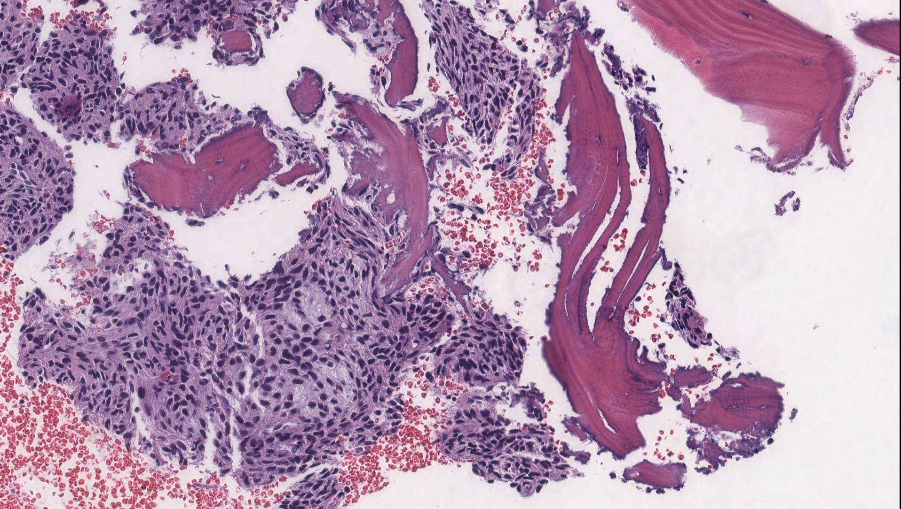

Slide 36
